Slide 1

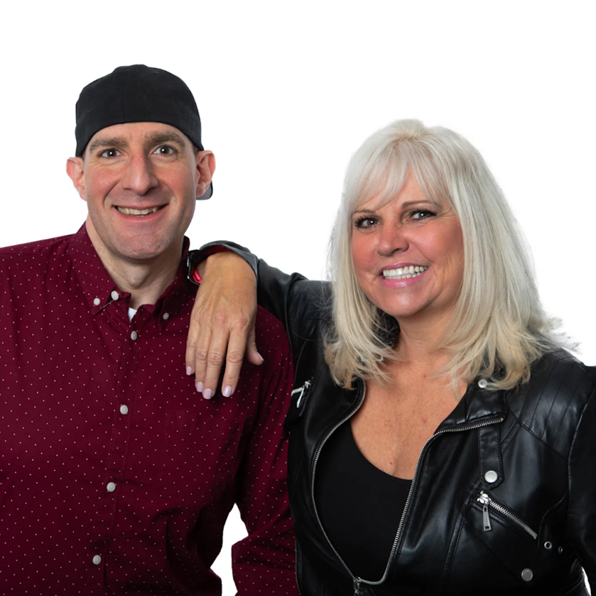


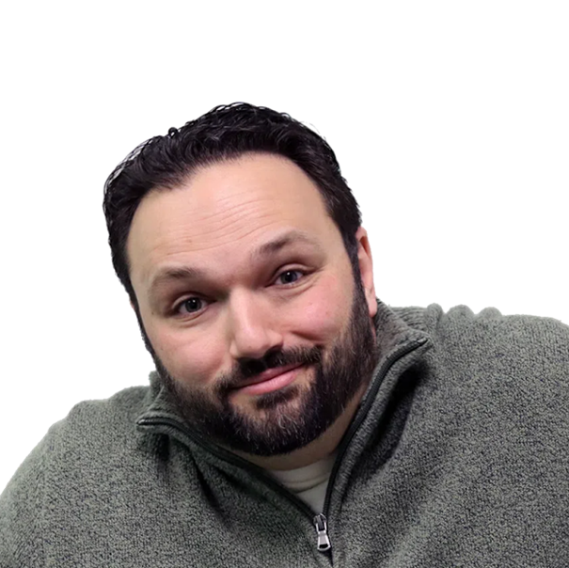









#5 in connected car listening over the past week with a 9% share and 13% cume!
Colorado’s
Cat Country 95.1!
Age Breakdown
Gender Breakdown
Lineup
56%
Female
Kincaid & Dallas
M-F 6a-10a
44%
Male
Middays W/
Megan Marie
M-F 10a-3p
Ridin Home W/
Roger
M-F 3p-7p
Connecting you with the REAL household
decision-makers.
Country Nights Live With Bev Rainey
M-F 7p-12a
78%
66%
64%
Homeowner
Employed
Married
The Overnight Ride With Justin Franiak
M-F 12a-6a
58%
64%
42%
31%
Earn $75,000+
Some college+
White collar
One+ children (<18)
2025 Xperi DTS Autostage; Dec 1-Dec 7; Share; Cume; Sample Size: 9,513 Cars; | Colorado Springs-Pueblo, CO; 2025 Spring MRI-Simmons Market-by-Market; A18+; Country format.
INSIGHTS BY
FuturiTopLine.com
Copyright © 2026 Futuri Media LLC, TOPLINE. All Rights Reserved

Slide 2



Cumulus Digital
Big or Small, We Do it All
KATC-FM - Website, Streaming, Email, App, and Display Statistics
Based on a 3-month average – Aug, Sept, Oct 2025
Streaming Metrics
Website & Email
Cumulus Station Digital Assets
Streaming Impressions:
Streaming Cume:
Streaming Listening Hours:
1,038,887
5,516
36,190
Page Views:
Website Visits:
Email Addresses:
3,974
2,468
2,162
Advertising opportunities include:
Station Streaming Sponsorships
In-Stream Ads
Display Ads
Desktop Homepage Takeovers
Video Pre-Roll Commercials
Mobile App
Facebook Boosted Post
Cumulus Station E-Newsletter
Cumulus Station Social Media
Custom Client Contests
App Metrics
Amazon Echo
App Starts:
App Downloads:
1,911
92
Session Starts:
Total Listening Hours:
5,024
15,923
Display & Social Media
Display Impressions
(November):
74,794
Meta/Facebook
Followers:
27,013
X (Twitter)
Followers:
2,862
Instagram
Followers:
1,563
Note: Display includes the station site, the player page, and the app ad unit data
INSIGHTS BY
FuturiTopLine.com
Copyright © 2026 Futuri Media LLC, TOPLINE. All Rights Reserved

