Slide 1














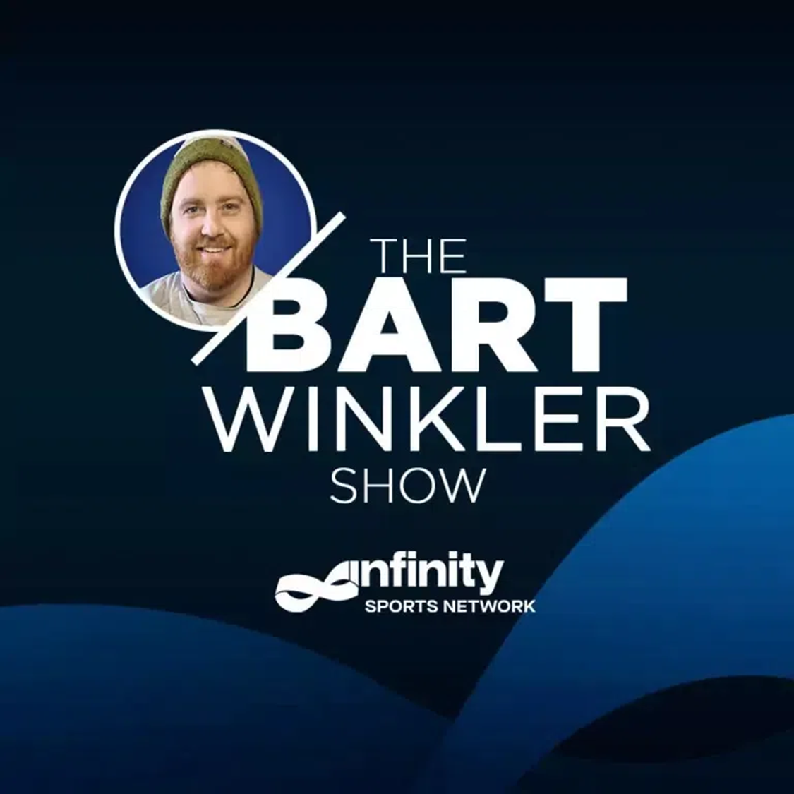



Southern Colorado’s Sports Leader
Age Breakdown
Gender Breakdown
Lineup
18%
Female
Maggie & Perloff
M-F 4a-7a
82%
Male
The Dan Patrick Show
M-F 7a-10a
The Rich Eisen Show
M-F 10a-1p
Capture affluent, educated, and influential members of
the community on Xtra Sports Radio 1300.
The Jim Rome Show
M-F 1p-3p
82%
76%
71%
Homeowners
Employed
Married
Drive Time Sports
With Ryan Kaufman
M-F 3p-6p
53%
53%
35%
JRSportBrief
M-F 6p-8p
Earn $100,000+
White collar
One+ children
(<18)
The Bart Winkler Show
M-F 8p-12a
57%
2x
More likely than the market average to have a postgraduate degree
More likely than the market average to own a business
The Pat Boyle Show
M-F 12a-4a
Colorado Springs-Pueblo, CO; 2025 Spring MRI-Simmons Market-by-Market; A18+; Sports format.
INSIGHTS BY
FuturiTopLine.com
Copyright © 2026 Futuri Media LLC, TOPLINE. All Rights Reserved

Slide 2



Cumulus Digital
Big or Small, We Do it All
KCSF-AM - Website, Streaming, Email, App, and Display Statistics
Based on a 3-month average – Aug, Sept, Oct 2025
Streaming Metrics
Website & Email
Cumulus Station Digital Assets
Streaming Impressions:
Streaming Cume:
Streaming Listening Hours:
186,546
4,671
9,759
Page Views:
Website Visits:
Email Addresses:
11,028
7,314
307
Advertising opportunities include:
Station Streaming Sponsorships
In-Stream Ads
Display Ads
Desktop Homepage Takeovers
Video Pre-Roll Commercials
Mobile App
Facebook Boosted Post
Cumulus Station E-Newsletter
Cumulus Station Social Media
Custom Client Contests
App Metrics
Amazon Echo
App Starts:
App Downloads:
1,098
53
Session Starts:
Total Listening Hours:
762
1,126
Display & Social Media
Display Impressions
(November):
55,460
Meta/Facebook
Followers:
1,561
X (Twitter)
Followers:
815
Instagram
Followers:
218
Note: Display includes the station site, the player page, and the app ad unit data
INSIGHTS BY
FuturiTopLine.com
Copyright © 2026 Futuri Media LLC, TOPLINE. All Rights Reserved

