Slide 1

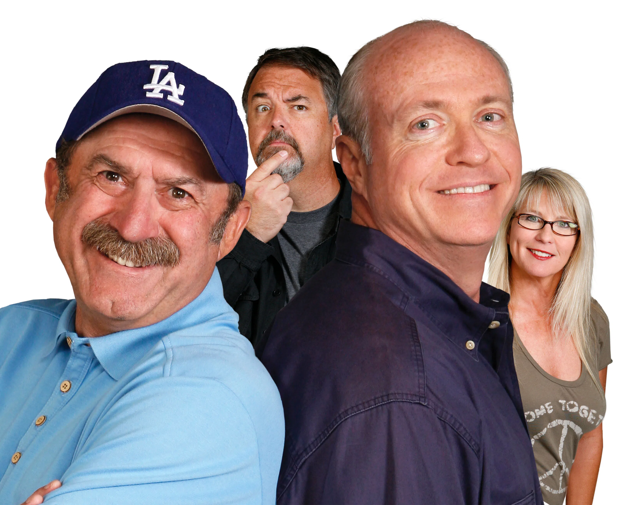

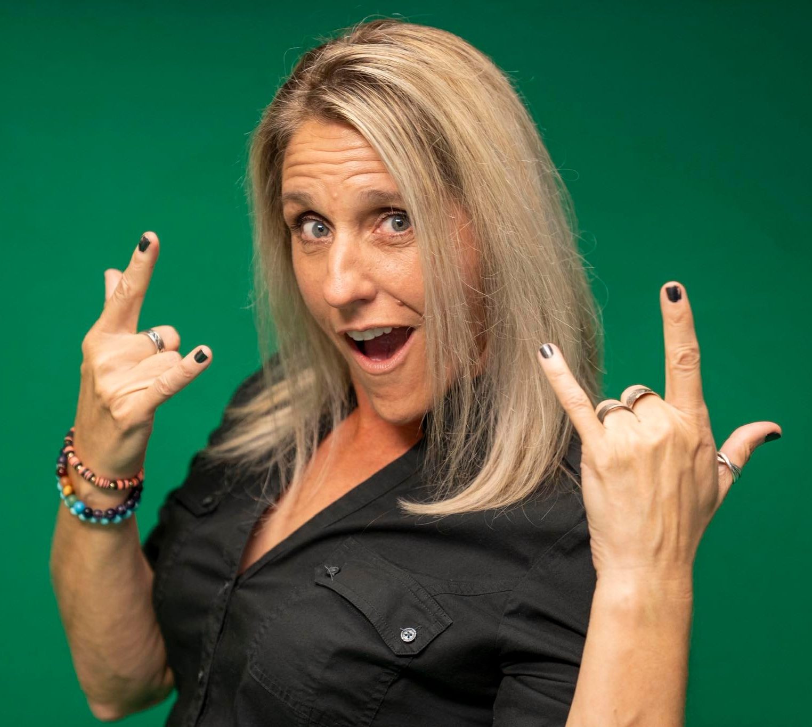




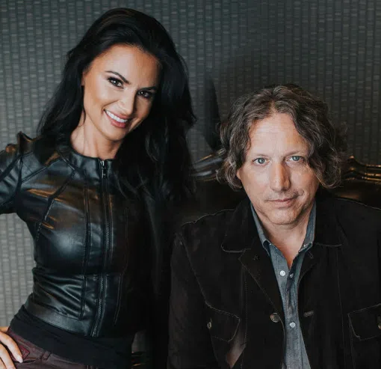




#4 in connected car listening over the past week with a 9% share and 13% cume!
Colorado's Only
Real Classic Rock
Age Breakdown
Gender Breakdown
Lineup
36%
Female
The Bob & Tom
Show
M-F 5a-10a
64%
Male
Gina Kavali
M-F 10a-2p
We deliver Classic Rock fans who've built modern,
successful lives.
Chris Austin
M-F 2p-7p
80%
64%
64%
Steve Gorman
Rocks!
M-Th 7p-3a, F 7p-12a
Homeowner
Employed
Married
52%
66%
44%
24%
Earn $75,000+
Some college+
White collar
One+ children (<18)
2025 Xperi DTS Autostage; Dec 1-Dec 7; Share; Cume; Sample Size: 9,513 Cars; | Colorado Springs-Pueblo, CO; 2025 Spring MRI-Simmons Market-by-Market; A18+; Classic Rock format.
INSIGHTS BY
FuturiTopLine.com
Copyright © 2026 Futuri Media LLC, TOPLINE. All Rights Reserved

Slide 2



Cumulus Digital
Big or Small, We Do it All
KKFM-FM - Website, Streaming, Email, App, and Display Statistics
Based on a 3-month average – Aug, Sept, Oct 2025
Streaming Metrics
Website & Email
Cumulus Station Digital Assets
Streaming Impressions:
Streaming Cume:
Streaming Listening Hours:
982,018
9,563
37,689
Page Views:
Website Visits:
Email Addresses:
6,640
3,704
4,998
Advertising opportunities include:
Station Streaming Sponsorships
In-Stream Ads
Display Ads
Desktop Homepage Takeovers
Video Pre-Roll Commercials
Mobile App
Facebook Boosted Post
Cumulus Station E-Newsletter
Cumulus Station Social Media
Custom Client Contests
App Metrics
Amazon Echo
App Starts:
App Downloads:
3,372
93
Session Starts:
Total Listening Hours:
3,845
9,252
Display & Social Media
Display Impressions
(November):
100,544
Meta/Facebook
Followers:
6,176
X (Twitter)
Followers:
290
Instagram
Followers:
678
Note: Display includes the station site, the player page, and the app ad unit data
INSIGHTS BY
FuturiTopLine.com
Copyright © 2026 Futuri Media LLC, TOPLINE. All Rights Reserved

