Slide 1



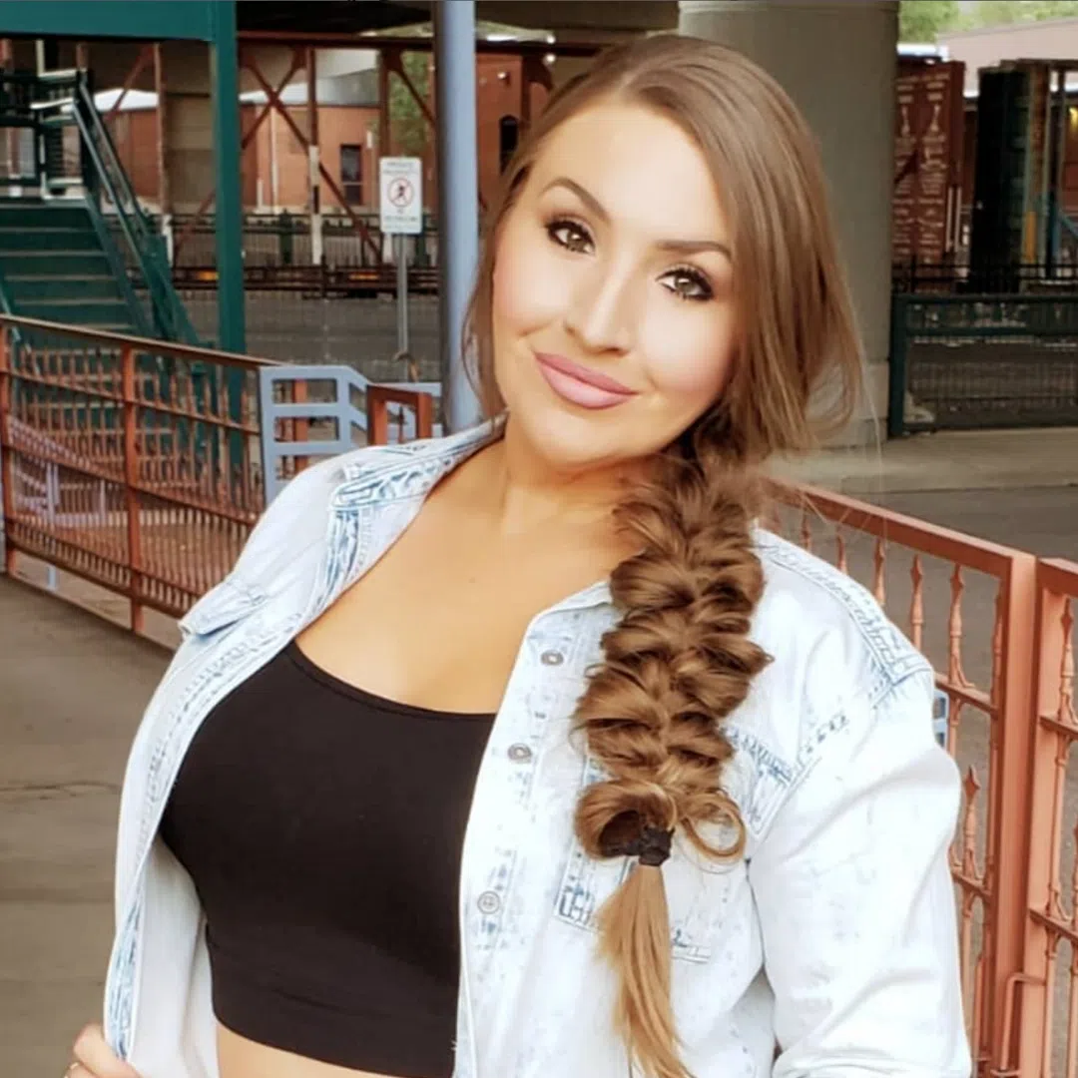
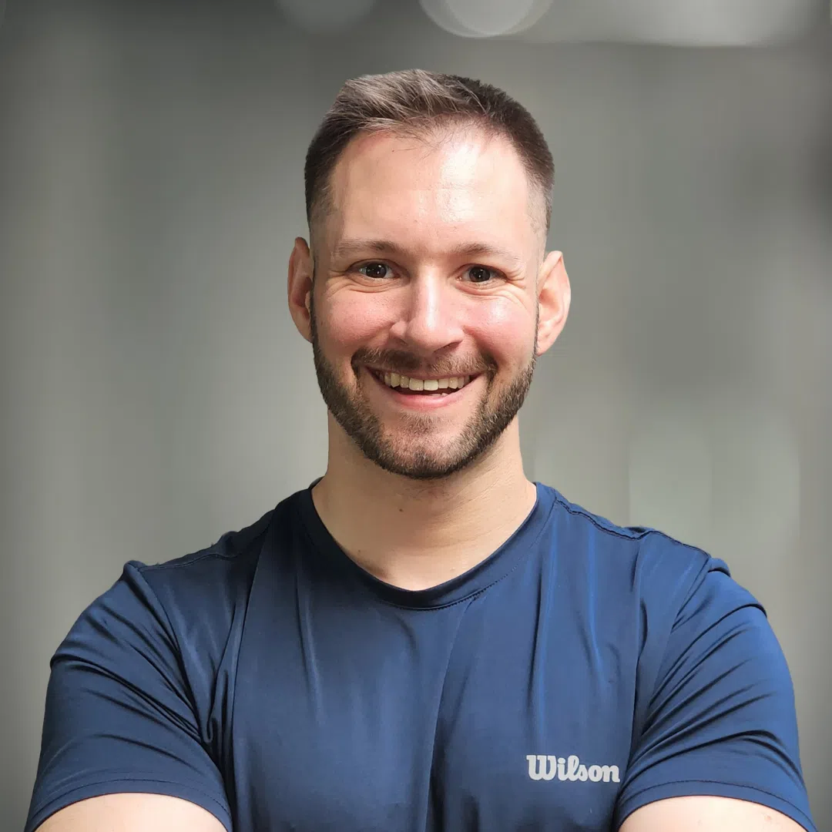



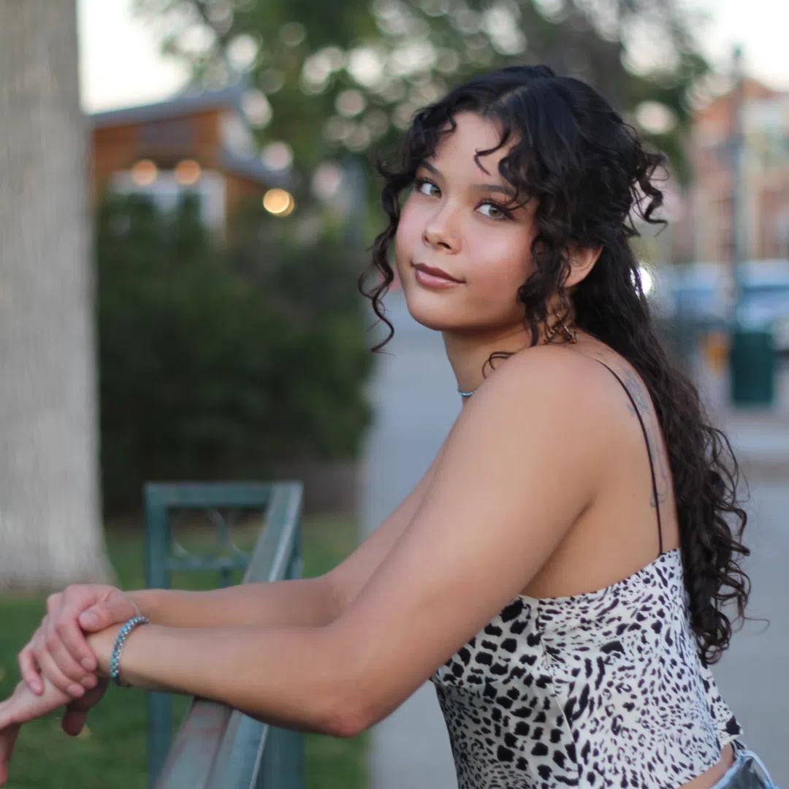





#1 in connected car listening over the past week with a 16% share and 19% cume!
Southern Colorado’s #1 Hit Music Station!
Age Breakdown
Gender Breakdown
Lineup
61%
Female
The Jubal Show
M-F 6a-10a
39%
Male
Dallace Jade
M-F 10a-3p
If you’re looking to reach an audience in the age of acquisition AND upgrades, look no further than Magic FM.
Jeff Haber
M-F 3p-7p
74%
65%
50%
Employed
Homeowners
Earn $75,000+
The Late Night Debrief With Soliyah Sage
M-F 7p-10p
41%
50%
63%
One+ children (<18)
White collar
Some college+
10%
Plan to purchase/lease a vehicle in the next year
54%
More likely than the market average to buy a second house or vacation home in the next year
2025 Xperi DTS Autostage; Dec 1-Dec 7; Share; Cume; Sample Size: 9,513 Cars; | Colorado Springs-Pueblo, CO; 2025 Spring MRI-Simmons Market-by-Market; A18+; CHR format.
INSIGHTS BY
FuturiTopLine.com
Copyright © 2026 Futuri Media LLC, TOPLINE. All Rights Reserved

Slide 2



Cumulus Digital
Big or Small, We Do it All
KKMG-FM - Website, Streaming, Email, App, and Display Statistics
Based on a 3-month average – Aug, Sept, Oct 2025
Streaming Metrics
Website & Email
Cumulus Station Digital Assets
Streaming Impressions:
Streaming Cume:
Streaming Listening Hours:
1,060,470
10,730
38,683
Page Views:
Website Visits:
Email Addresses:
9,604
4,916
7,365
Advertising opportunities include:
Station Streaming Sponsorships
In-Stream Ads
Display Ads
Desktop Homepage Takeovers
Video Pre-Roll Commercials
Mobile App
Facebook Boosted Post
Cumulus Station E-Newsletter
Cumulus Station Social Media
Custom Client Contests
App Metrics
Amazon Echo
App Starts: App Downloads:
2,206 116
Session Starts: Total Listening Hours:
5,395 12,777
Display & Social Media
Display Impressions (November): 89,210
Meta/Facebook Followers: 23,555
X (Twitter) Followers: 1,581
Instagram Followers: 7,225
Note: Display includes the station site, the player page, and the app ad unit data
INSIGHTS BY
FuturiTopLine.com
Copyright © 2026 Futuri Media LLC, TOPLINE. All Rights Reserved

