Slide 1

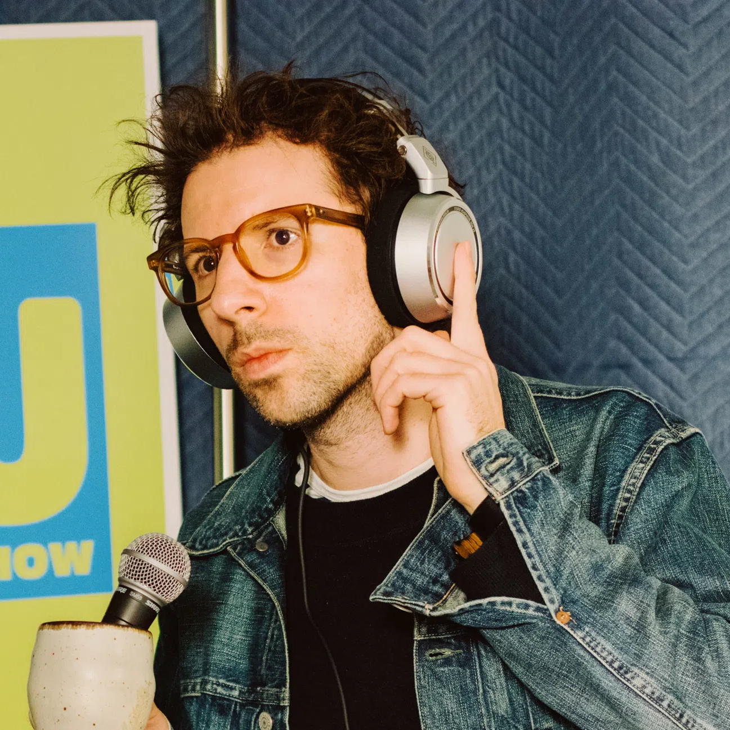






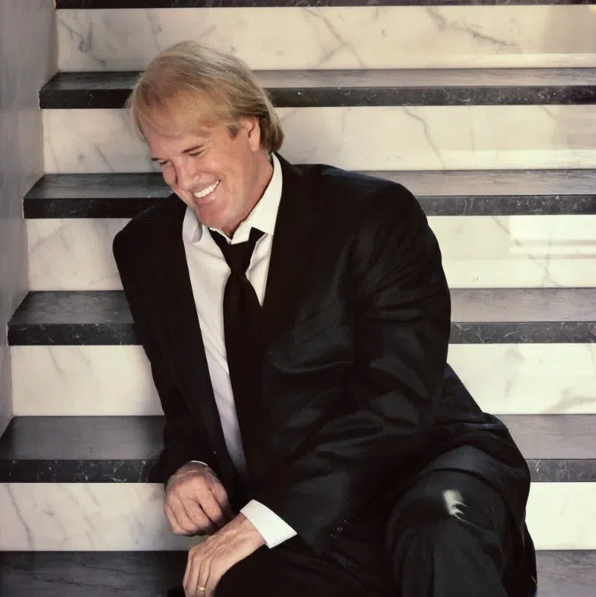





Mountain of Favorite Songs
#2 in connected car listening over the past week
with a 13% share and 16% cume!
Age Breakdown
Gender Breakdown
Lineup
60%
Female
The Tj Show
M-F 6a-10a
40%
Male
Woody
M-F 10a-3p
Our audience isn't just listening—they're living, earning,
and investing in what's next.
73%
68%
53%
Coyote Mccloud
M-F 3p-7p
Homeowners
Employed
Earn $75,000+
45%
33%
66%
John Tesh
M-F 7p-12a
White collar
One+ children
(<18)
Some college+
13%
Plan to purchase/lease a vehicle in the next year
10%
More likely than the market average to remodel their kitchen in the next year
2025 Xperi DTS Autostage; Dec 1-Dec 7; Share; Cume; Sample Size: 9,513 Cars; | Colorado Springs-Pueblo, CO; 2025 Spring MRI-Simmons Market-by-Market; A18+; AC format.
INSIGHTS BY
FuturiTopLine.com
Copyright © 2026 Futuri Media LLC, TOPLINE. All Rights Reserved

Slide 2



Cumulus Digital
Big or Small, We Do it All
KKPK-FM - Website, Streaming, Email, App, and Display Statistics
Based on a 3-month average – Aug, Sept, Oct 2025
Streaming Metrics
Website & Email
Cumulus Station Digital Assets
Streaming Impressions:
Streaming Cume:
Streaming Listening Hours:
769,070
3,565
28,007
Page Views:
Website Visits:
Email Addresses:
4,144
2,227
165
Advertising opportunities include:
Station Streaming Sponsorships
In-Stream Ads
Display Ads
Desktop Homepage Takeovers
Video Pre-Roll Commercials
Mobile App
Facebook Boosted Post
Cumulus Station E-Newsletter
Cumulus Station Social Media
Custom Client Contests
App Metrics
Amazon Echo
App Starts:
App Downloads:
1,596
69
Session Starts:
Total Listening Hours:
4,544
13,287
Display & Social Media
Display Impressions
(November):
49,403
Meta/Facebook
Followers:
35,993
X (Twitter)
Followers:
995
Instagram
Followers:
596
Note: Display includes the station site, the player page, and the app ad unit data
INSIGHTS BY
FuturiTopLine.com
Copyright © 2026 Futuri Media LLC, TOPLINE. All Rights Reserved

