Slide 1
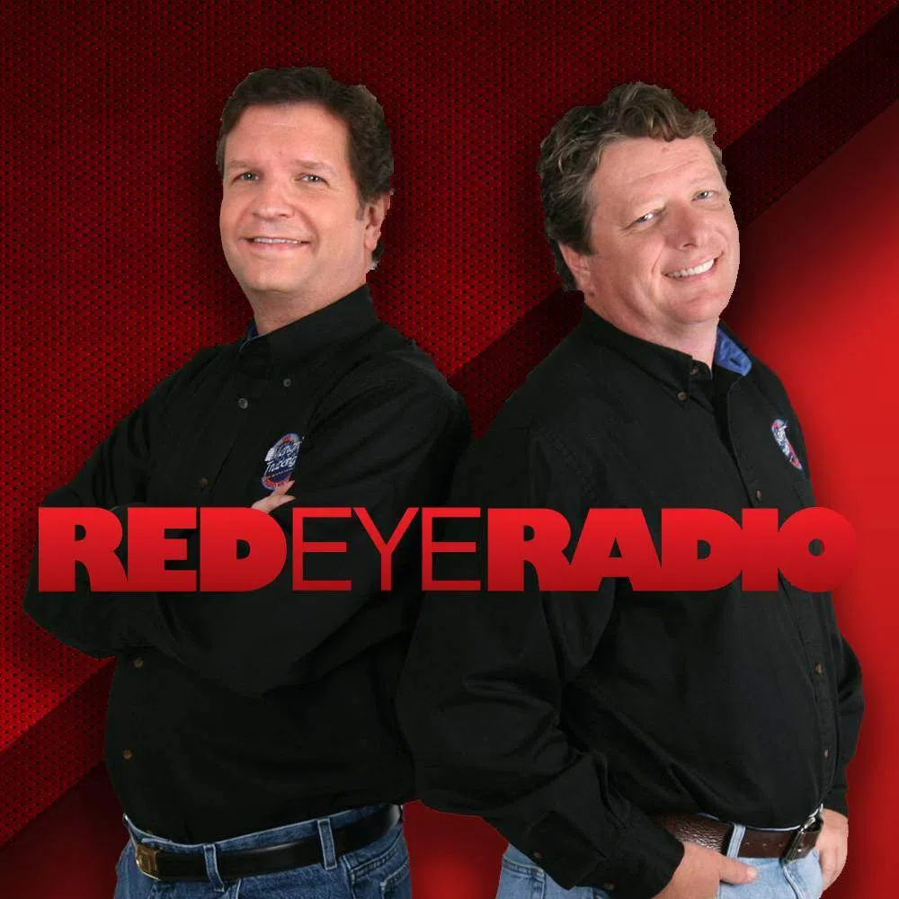












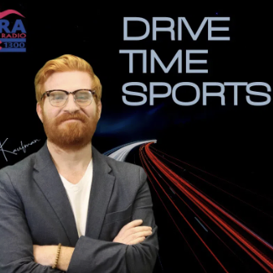
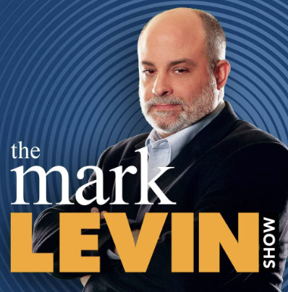


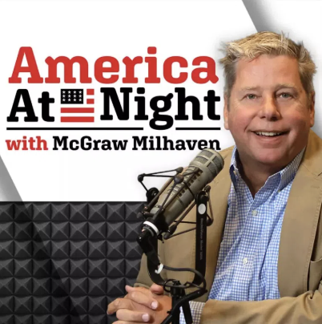


Local Colorado Morning News with Jim Arthur,
The Richard Randall Show, Drive Time Sports, Air Force Athletics, News/Weather/Traffic, Best in Conservative News Talk for over 100 years!
Lineup
Age Breakdown
Gender Breakdown
Red Eye Radio
M-F 12a-4a
41%
Female
America in the Morning M-F 4a-5a
Colorado Springs
Morning News
M-F 5a-8a
59%
Male
The Richard Randall Show
M-F 8a-10a
Our listeners lead—in business, in their communities, and in their households.
The Vince Show
M-F 10a-1p
Lifestyles Unlimited
M-F 1p-3p
87%
60%
67%
52%
Homeowners
Employed
Married
Earn
$100,000+
Drive Time Sports with Ryan Kaufman
M-F 3p-6p
45%
More likely than the market average to have a postgraduate degree
Mark Levin
M-F 6p-9p
63%
White collar
America at Night with McGraw Milhaven
M-F 9p-12a
75%
More likely than the market average to own a business
38%
More likely than the market average to have used a financial advisor in the past year
Colorado Springs-Pueblo, CO; 2025 Spring MRI-Simmons Market-by-Market; A18+; News/Talk format; | Website, Streaming, Email, App, and Display Statistics: based on a 3-month average – Aug, Sept, Oct - 2025.
INSIGHTS BY
FuturiTopLine.com
Copyright © 2026 Futuri Media LLC, TOPLINE. All Rights Reserved

Slide 2



Cumulus Digital
Big or Small, We Do it All
KVOR-AM - Website, Streaming, Email, App, and Display Statistics
Based on a 3-month average – Aug, Sept, Oct 2025
Streaming Metrics
Website & Email
Cumulus Station Digital Assets
Streaming Impressions:
Streaming Cume:
Streaming Listening Hours:
1,442,199
18,659
56,843
Page Views:
Website Visits:
Email Addresses:
17,542
11,328
3,463
Advertising opportunities include:
Station Streaming Sponsorships
In-Stream Ads
Display Ads
Desktop Homepage Takeovers
Video Pre-Roll Commercials
Mobile App
Facebook Boosted Post
Cumulus Station E-Newsletter
Cumulus Station Social Media
Custom Client Contests
App Metrics
Amazon Echo
App Starts: App Downloads:
5,724 106
Session Starts: Total Listening Hours:
6,583 7,887
Display & Social Media
Display Impressions (November): 260,863
Meta/Facebook Followers: 3,154
X (Twitter) Followers: 1,600
Instagram Followers: 70
Note: Display includes the station site, the player page, and the app ad unit data
INSIGHTS BY
FuturiTopLine.com
Copyright © 2026 Futuri Media LLC, TOPLINE. All Rights Reserved

